Slide 1
Tic Tac Toe
Two players, X and O, who take turns marking the spaces in a 3×3 grid. The player who succeeds in placing three of their marks in a horizontal, vertical, or diagonal row is the winner.

Slide 2
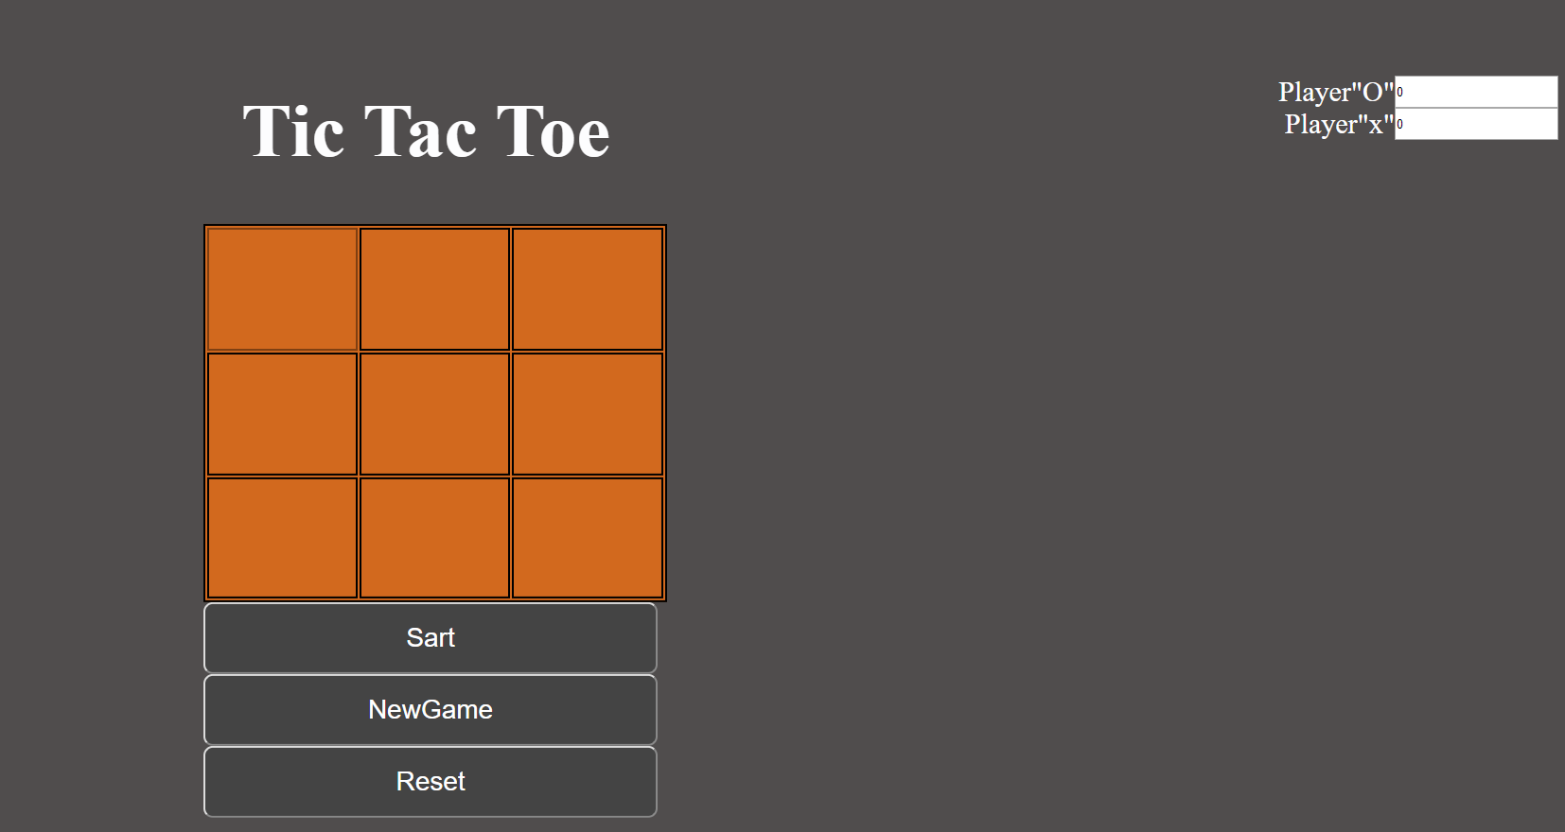

Slide 3
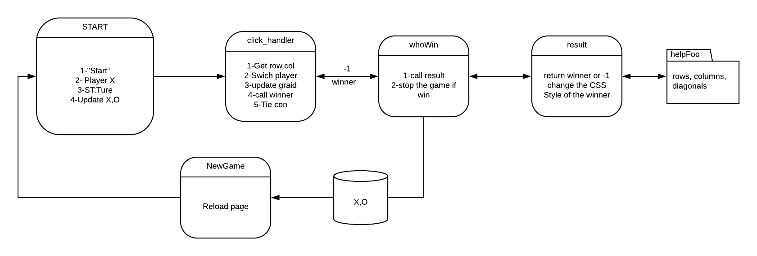
1- JS source code is never "read" line-by-line 2- using then() method to solve the problem. 3- Using Debugger tool save me time

Slide 4
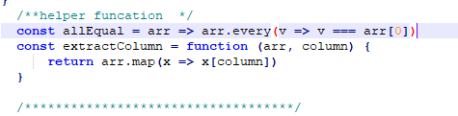

Slide 5
Tic Tac Toe Features
Keep track of multiple game rounds with a win,lose (not include tie )
Use localStorage to persist data locally to allow games to continue after page refresh or loss of internet connectivity.

Slide 6
Demo
https://obal3588.github.io/SEI-PRO11/

